Slide 1
Metrash2
HOW TO APPLY FOR PERMANENT FAMILY (RESIDENT) VISA for Sponsored Qatari ID-holding Employee
November 2019

Slide 2
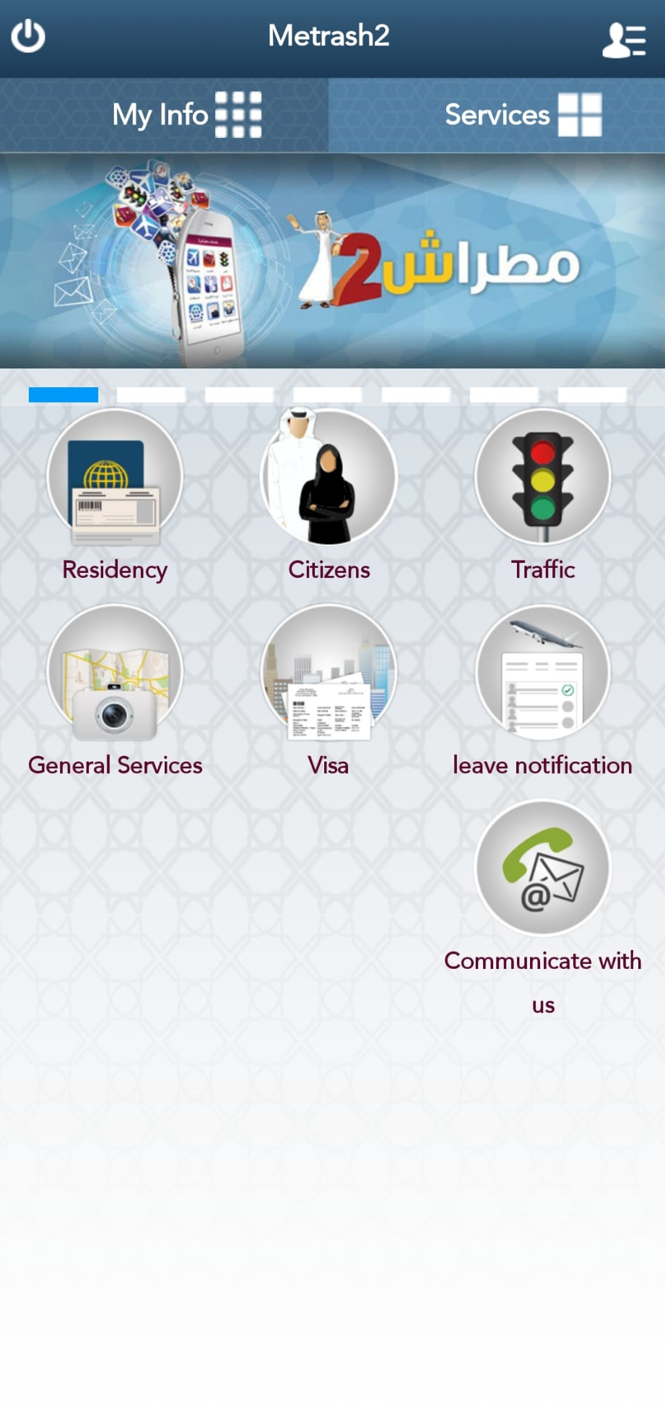
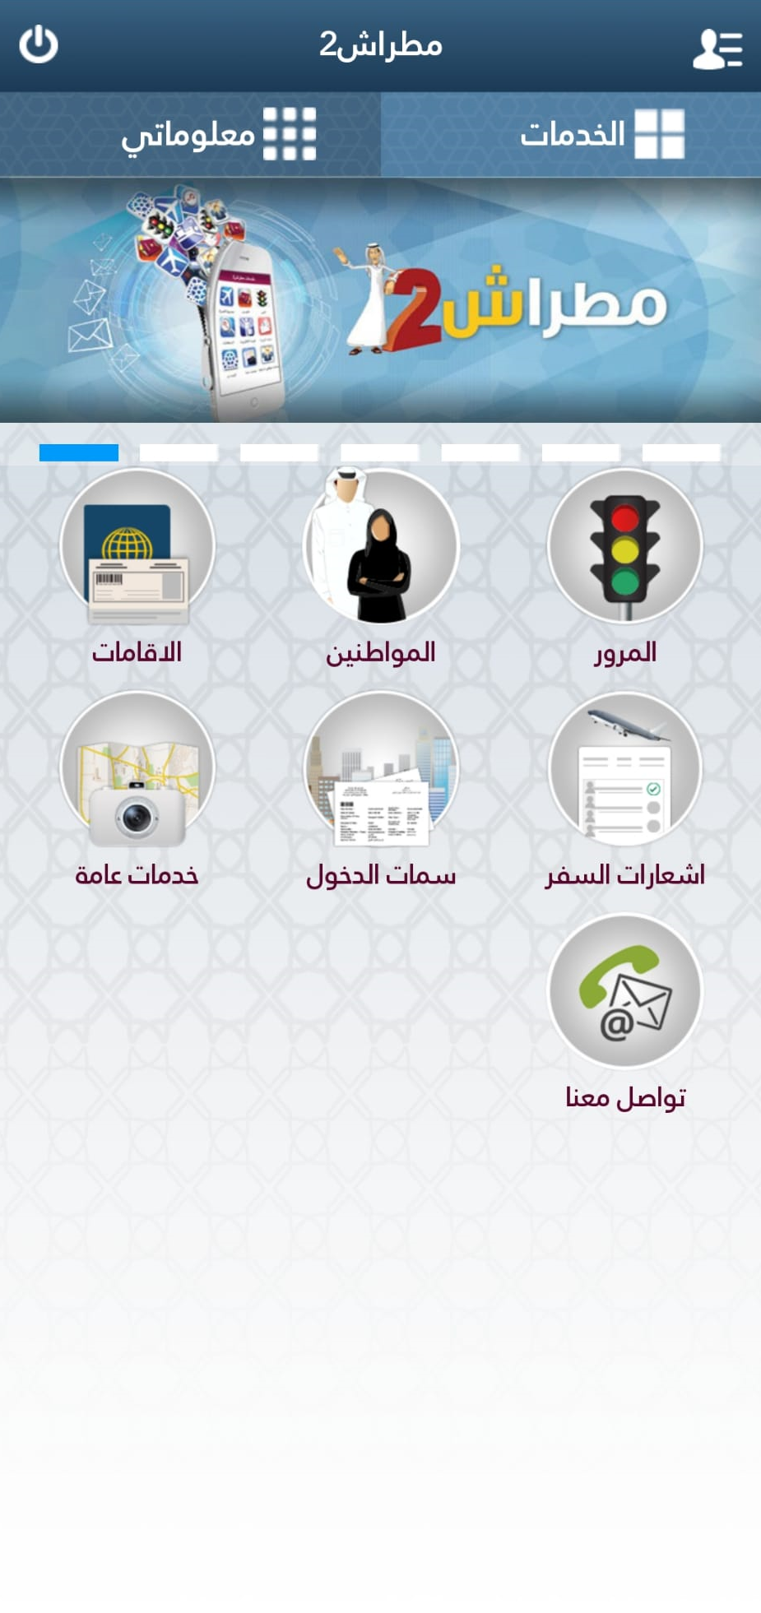

1. Select Visa.

Slide 3
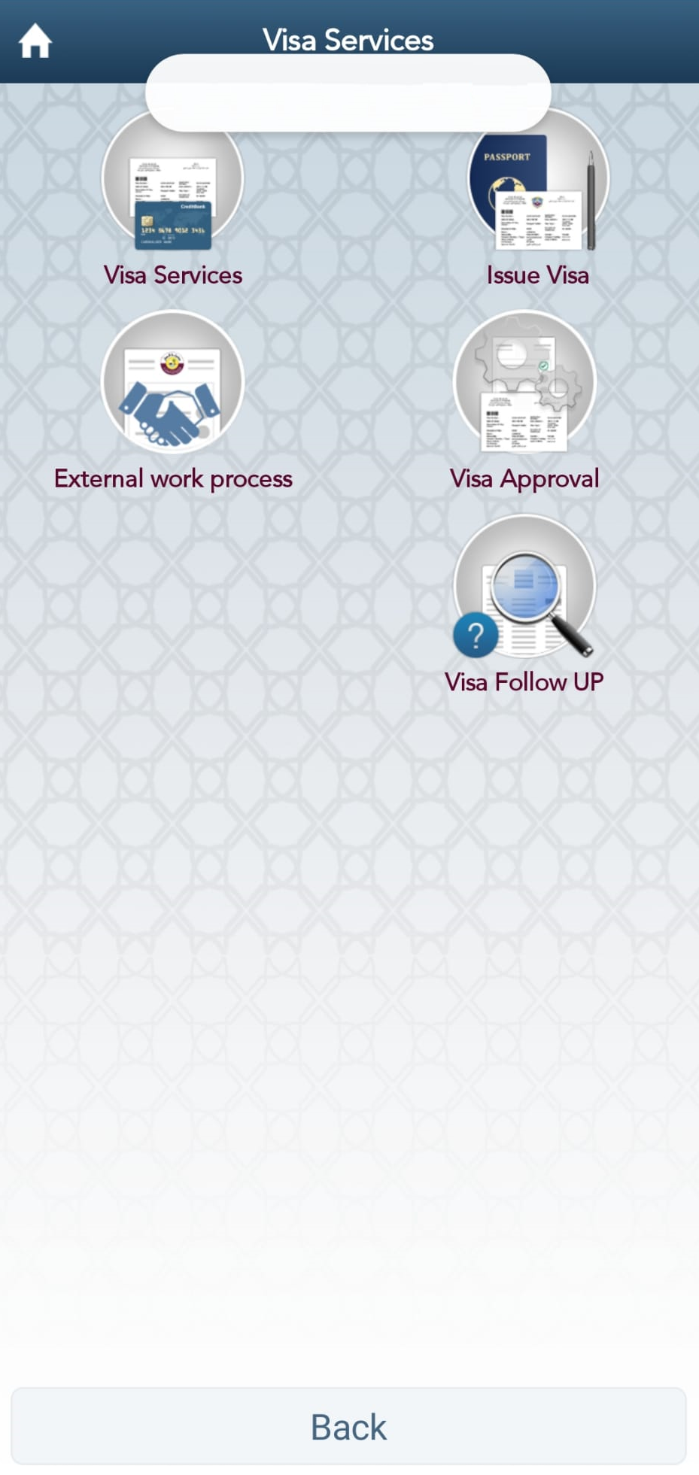
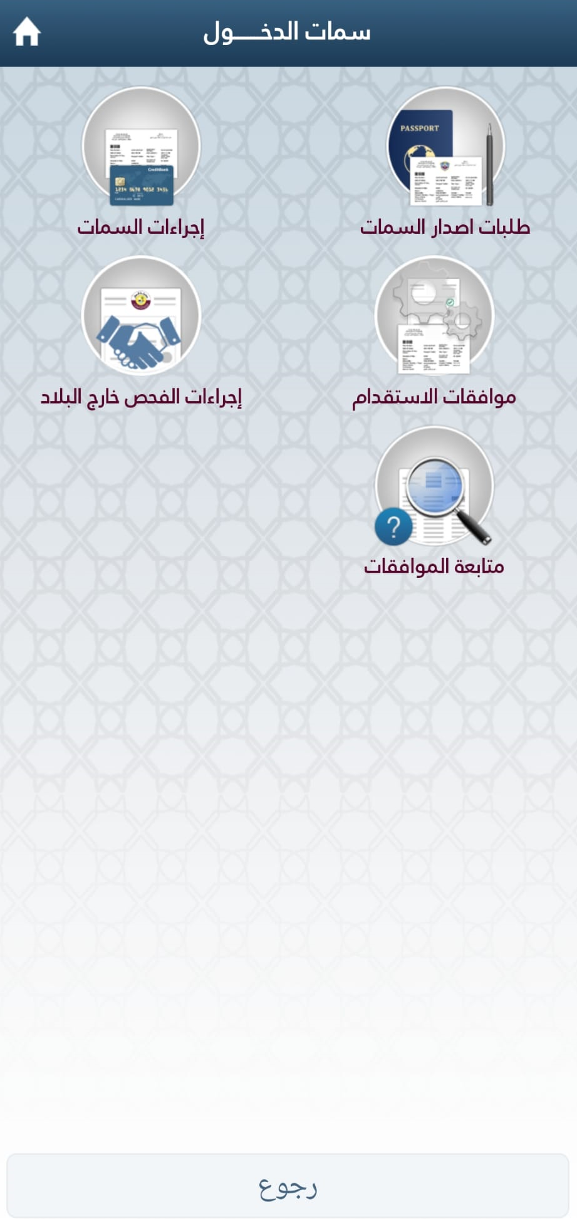
2. Select Issue Visa.

Slide 4
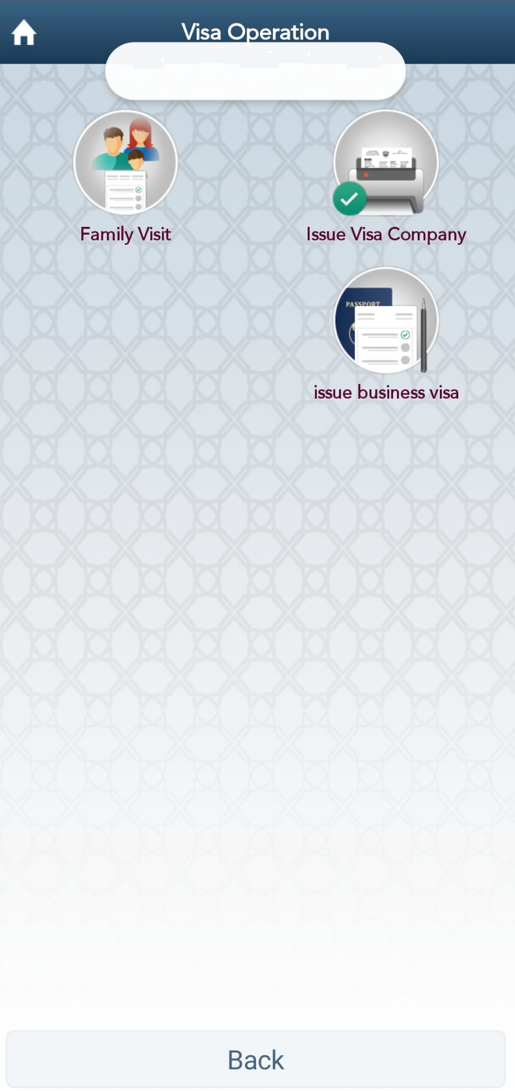
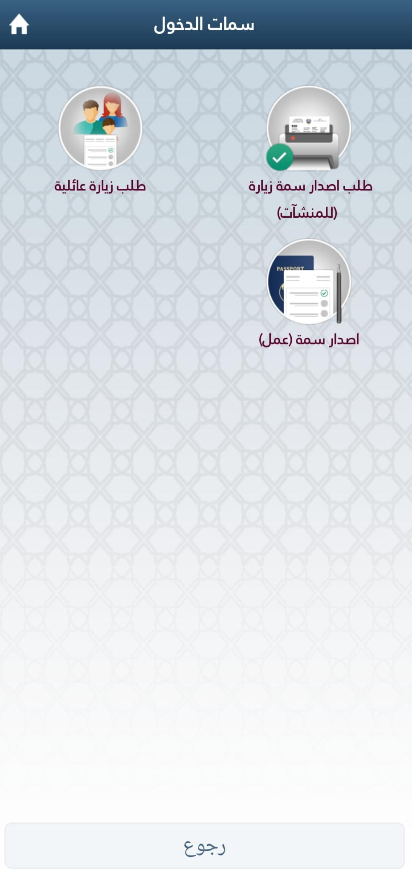
3. Select Family Visit.

Slide 5
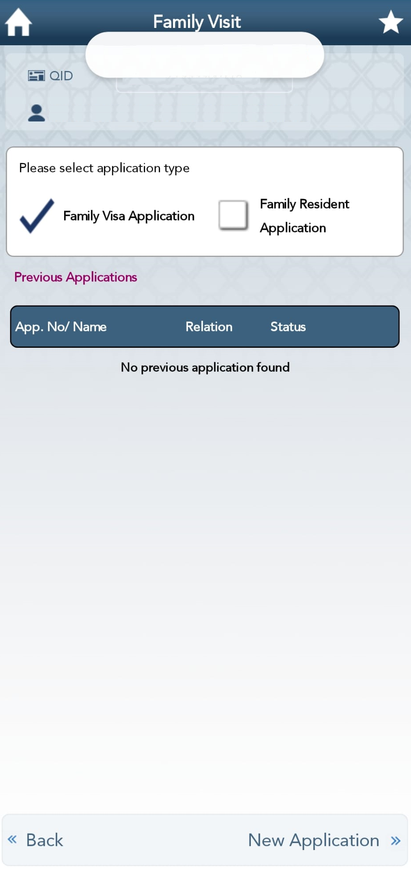
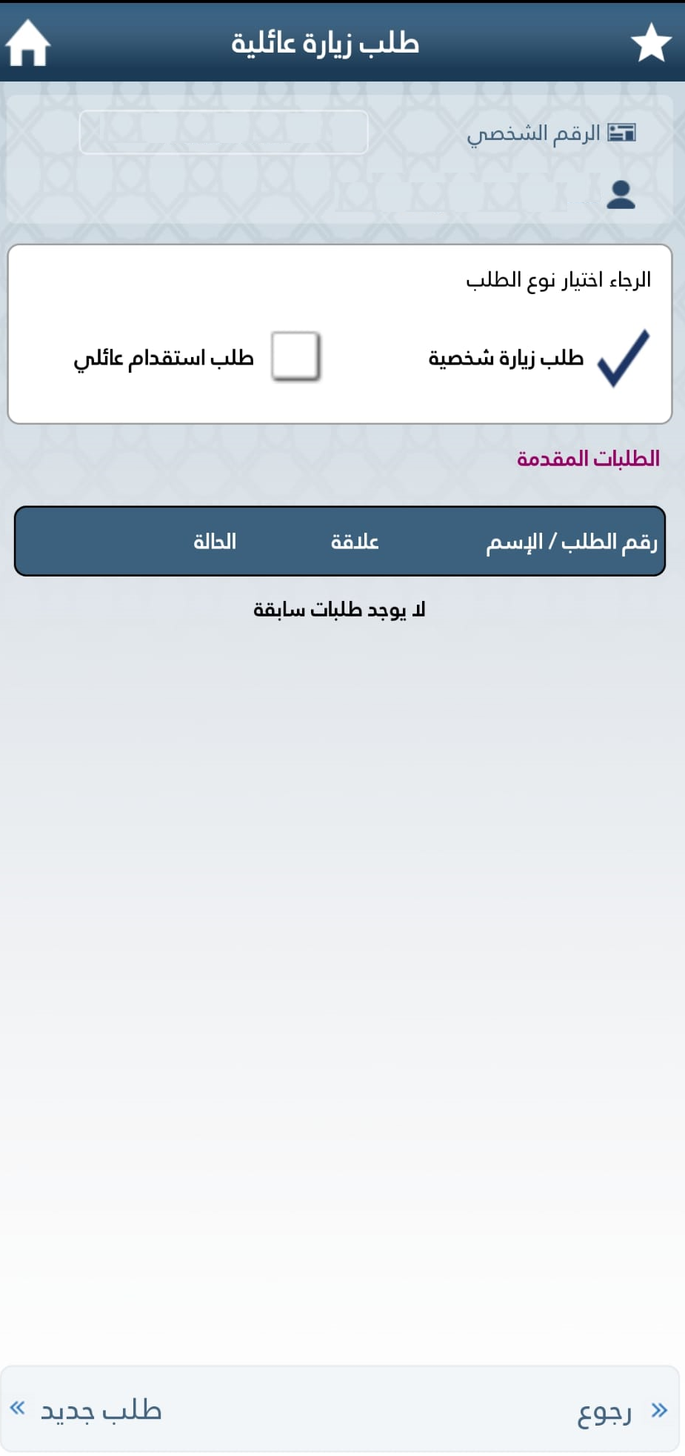
4. Select Family Resident Application tick box and then select New Application.

Slide 6
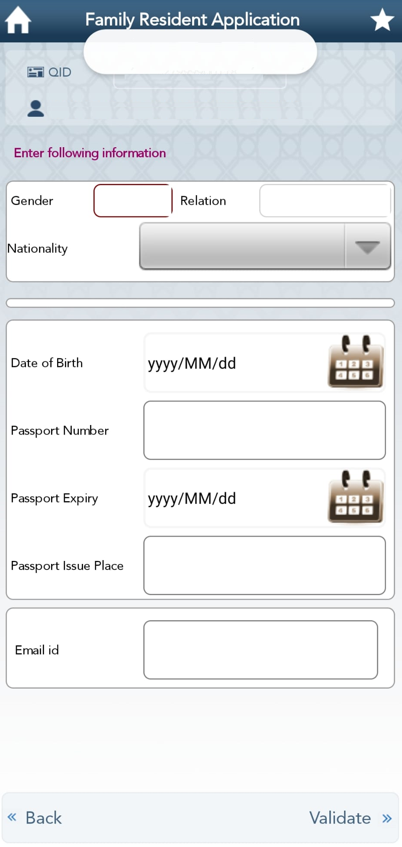
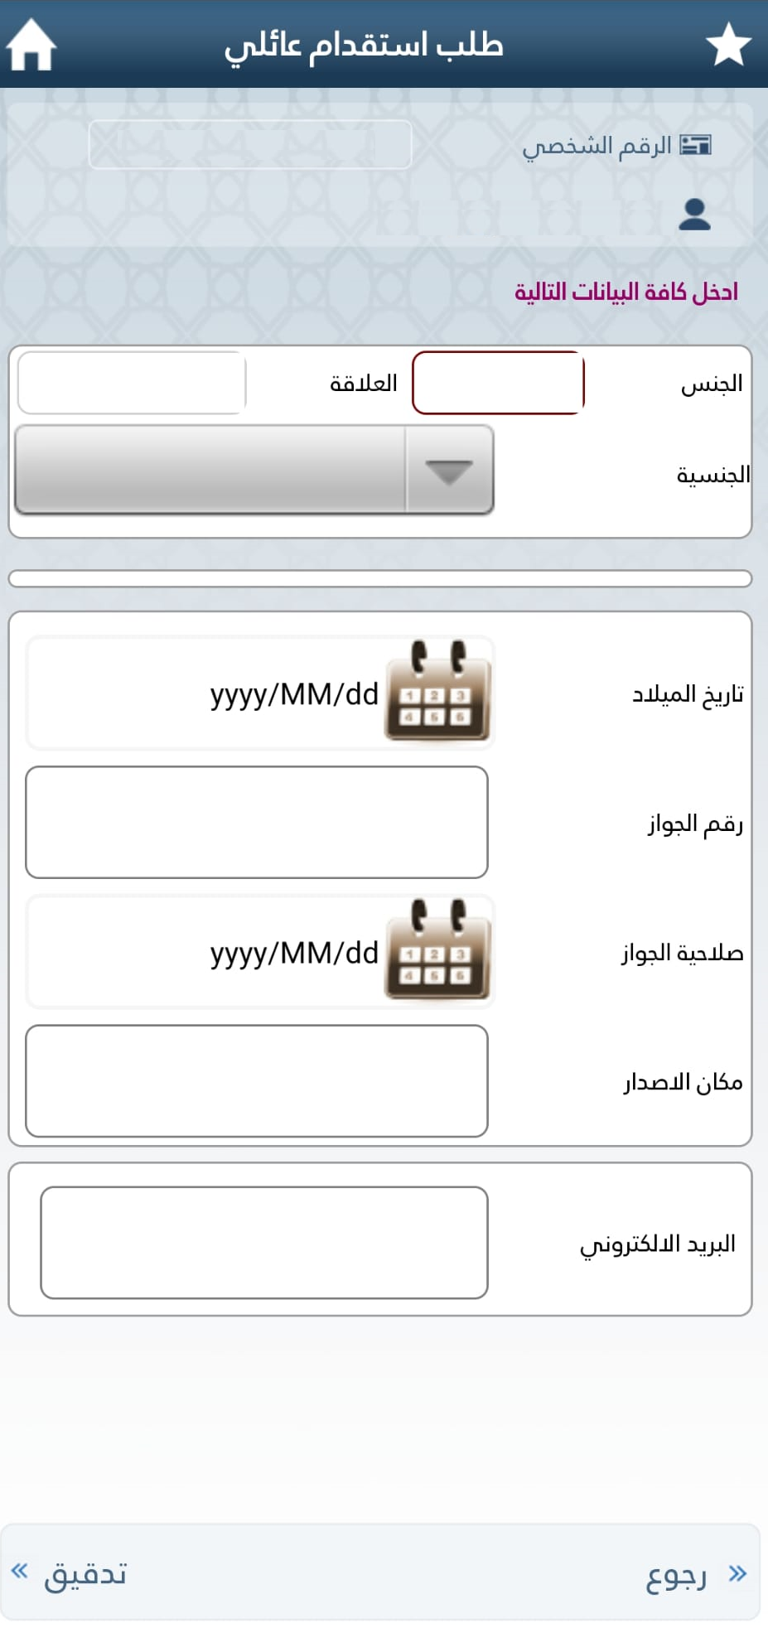
5. Complete the form and select VALIDATE and then in the next page, attach the supporting documentations.

